Slide 1
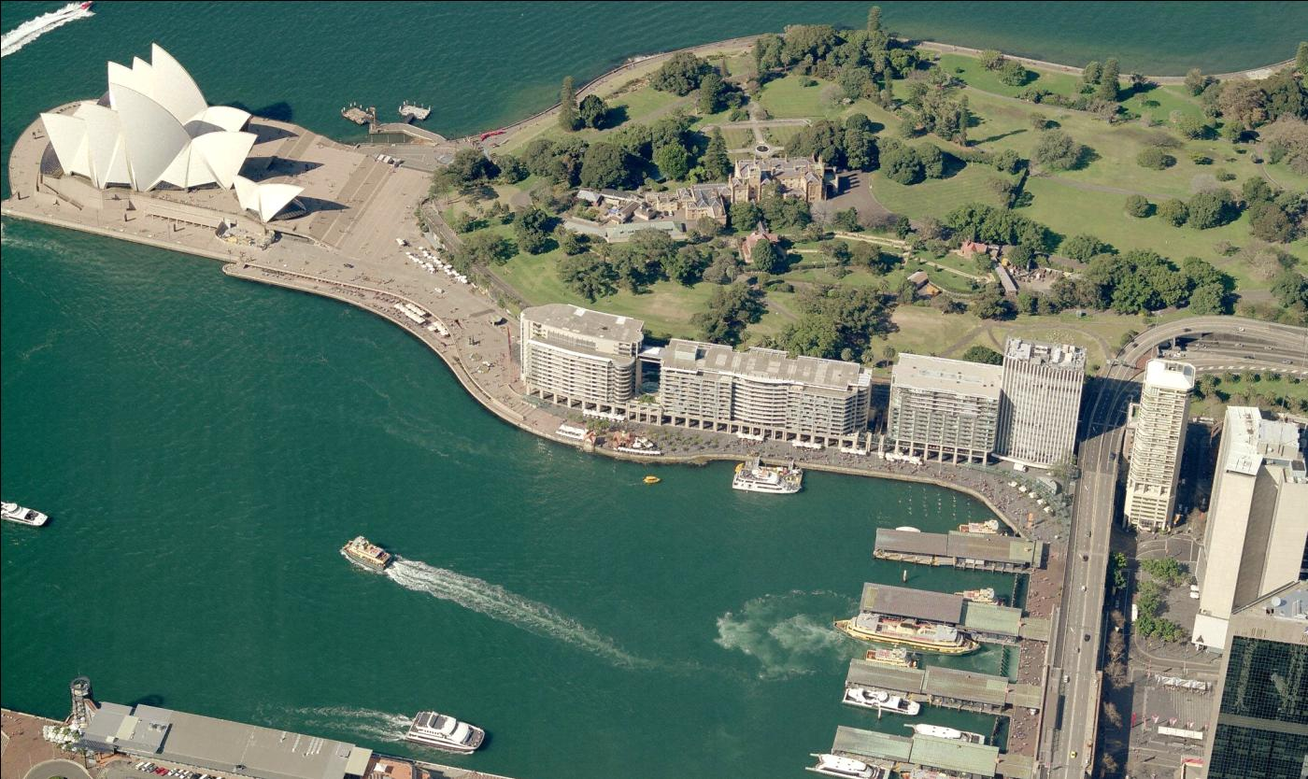



71 MACQUARIE STREET_
December 2010

Slide 2
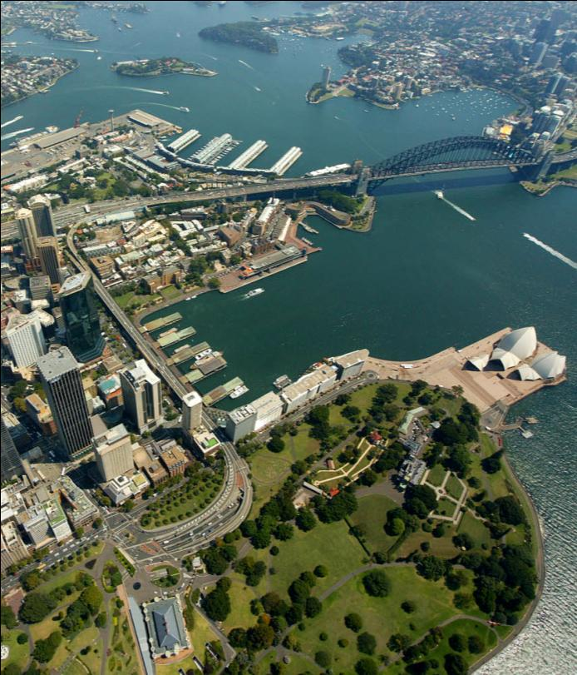
71 MACQUARIE STREET
Background
  _AMP Capital Investors have an opportunity to re-develop the Amital site at 71 Macquarie Street
  Mirvac have been invited to partner on the project given their proven track record in delivering residential and hotel style serviced apartments
  The site is part of the Circular Quay precinct subject to the Major Projects SEPP
  There is currently a great opportunity to integrate with the adjacent Council owned land to remove service traffic from the promenade, extend the colonnade and revitalise the public domain
  Public domain improvements could be funded by an integrated project and allowing retention of the existing building height
  The revitalisation of the public domain will contribute to realisation of Council’s 2030 vision

Slide 3
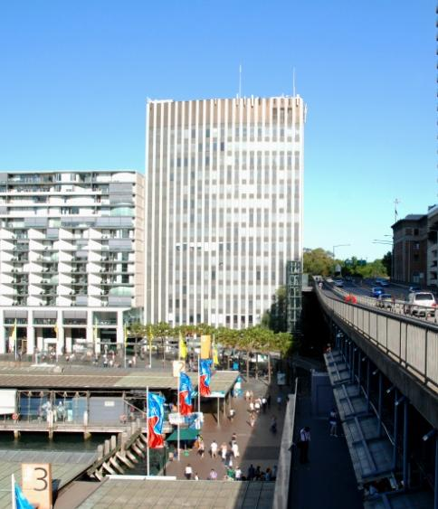
71 MACQUARIE STREET
Urban Design Principles
  With an integrated development the following urban design principles could apply:
  _Ensure alignment with SHFA master plan to complete the vision of the East Circular Quay precinct
  Remove vehicle traffic from East Circular Quay promenade
  Revitalise and activate the unsightly corner of Circular Quay and create a new and usable public domain
  Complete the colonnade and activate the ground plane
  Improve critical view lines in public spaces and from relevant neighbouring residential properties
  Create a pedestrian link to the Botanical Gardens

Slide 4
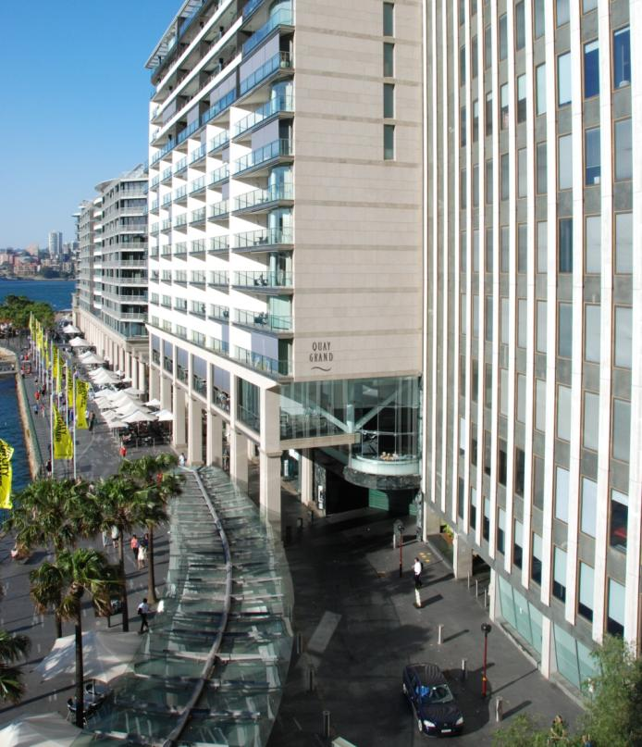
71 MACQUARIE STREET
Architectural Design Principles
  With an integrated development the following architectural design principles could apply:
  _Integrate the built form with the massing and design of the adjacent East Circular Quay buildings
  _Explore potential to extend the built form to the west over portion of Council roadway, and integrate with colonnade
  _Maintain existing building height with no additional overshadowing to adjacent parkland
  Explore potential a mix of residential and serviced apartment uses with opportunity to integrate and link to adjacent Quay Grand
  Achieve design excellence and enhanced environmental performance

Slide 5
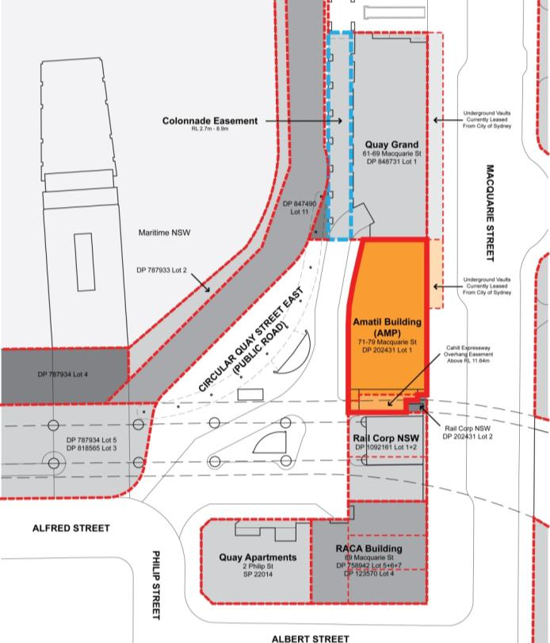
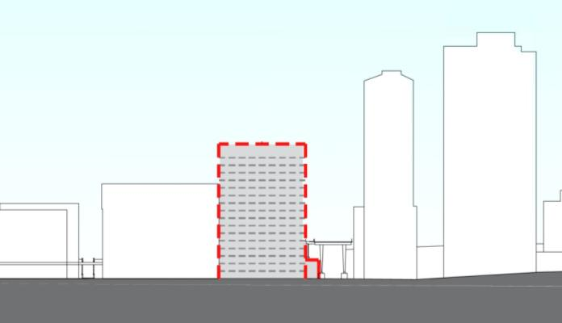
71 MACQUARIE STREET
Land Ownership
  AMP (Amatil Building)
  City of Sydney (public road)
  Quay Grand Colonnade Easement
Existing Building Envelope
Existing Substation
  Existing Land Ownership Plan

Slide 6
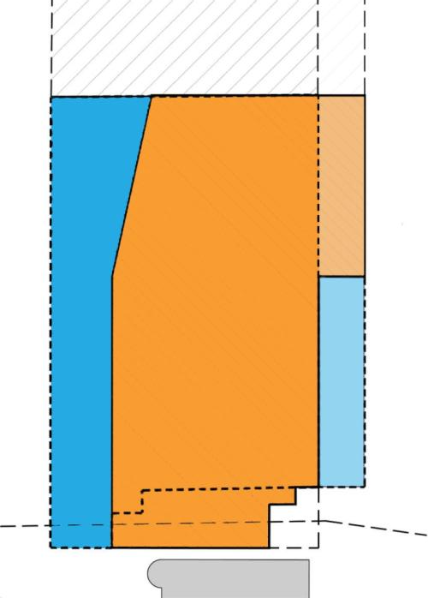
71 MACQUARIE STREET
Land Ownership
  Existing site area – 890 sqm
  (Excluding additional CoS land)
  CoS LEP 2005 FSR – 15.4:1*
  CoS LEP 2005 FSA – 13,706sqm
  Proposed FSR – 14.4:1
  Proposed FSA – 12,819sqm
QUAY GRAND
EXISTING LEASED BASEMENT LAND
POTENTIAL COLONNADE AND BUILDING OVER
EXISTING LEASED BASEMENT LAND
Base FSR is 8:1, with additional 6:1 for residential, serviced apartment & hotel uses. This gives a maximum of 14:1. A total of 15.4:1 would include an additional 10% as applied under clause 10 of the LEP.
CIRCULAR QUAY EAST
71 MACQUARIE STREET
SITE AREA 890 sqm
POTENTIAL ADDITIONAL LEASED BASEMNT LAND
MACQUARIE STREET
CAHILL EXPRESSWAY
  Proposed Land Ownership Plan

Slide 7
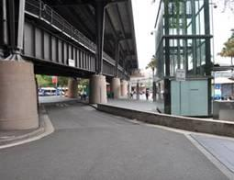
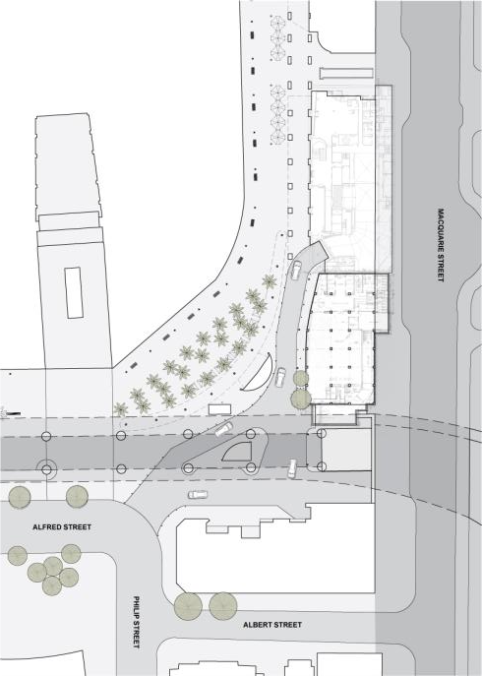

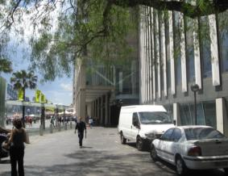
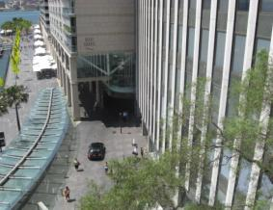
71 MACQUARIE STREET
Public Domain Analysis
Proposed Vehicular Traffic & Access
Existing_
Proposed_
ROAD TO BE REMOVED
BASEMENT LINK TO QUAY GRAND
ADDITIONAL NEW PUBLIC SPACE
2 WAY ROAD
Current vehicular entry to Quay Grand through East Circular Quay produces a compromised share zone.
Proposed scheme offers opportunities to remove traffic from East Circular Quay by diverting it through the 71 Macquarie St basement. This provides greater public space and separated vehicular and pedestrian circulation.
Existing photos of shared zone.

Slide 8
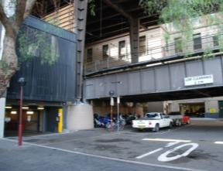
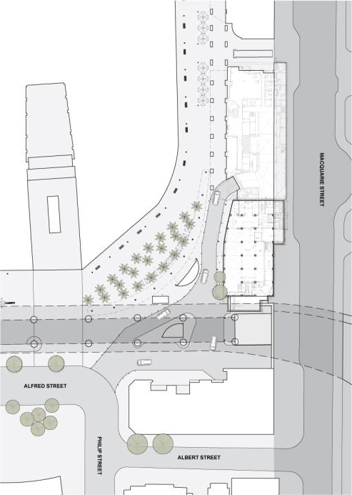
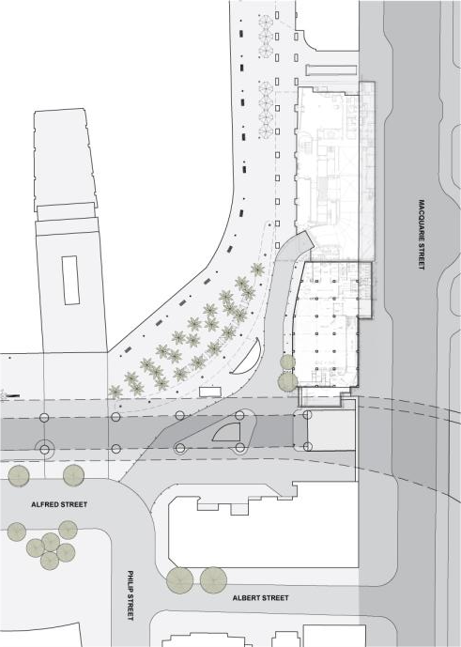
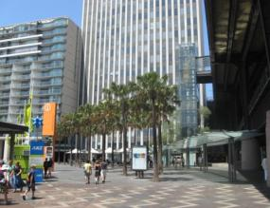
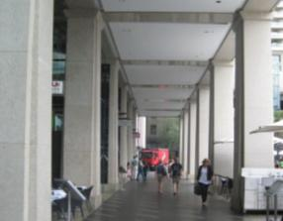
71 MACQUARIE STREET
Public Domain Analysis
Proposed Colonnade & Active Edges
Existing_
Proposed_
Option 1
COMPLETE COLONNADE
NEW PUBLIC SPACE
THROUGH SITE LINK
Current termination of the colonnade results in a degraded and inactive ground plane. This corner of the Circular Quay is predominantly unused.
Proposed scheme extends the colonnade so to revitalise and activate the unused corner of space. The new public domain also provides a link to the Botanical Gardens.
Photos of existing shared zone and active colonnade.

Slide 9
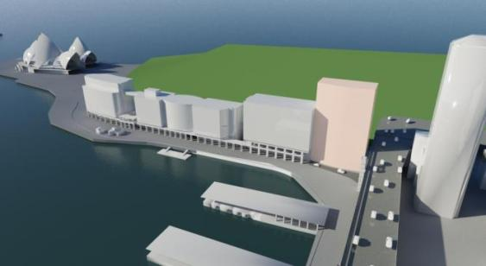
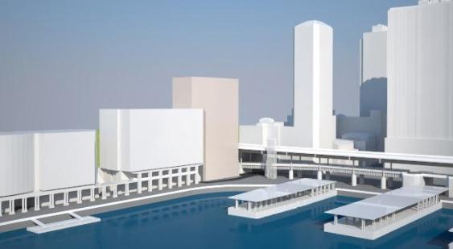
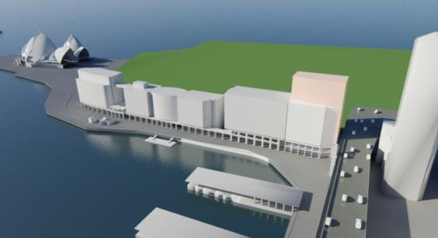
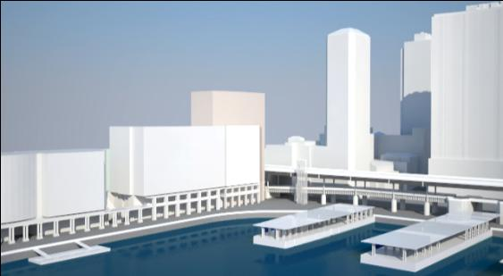
71 MACQUARIE STREET
Massing Studies
Existing_
Existing building to remain
Potential Option_
Integrated Development
Residential conversion on AMP site and roadway with integrated colonnade. Potential for revised access to Quay Grand and improved Circular Quay public domain. Subject to Council agreement (land owner).

Slide 10
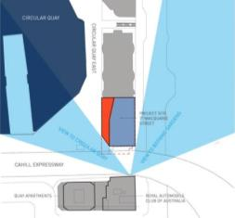
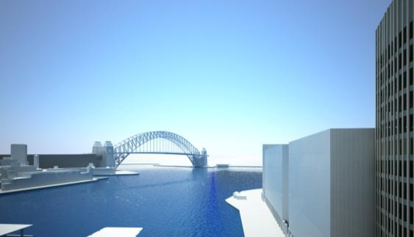
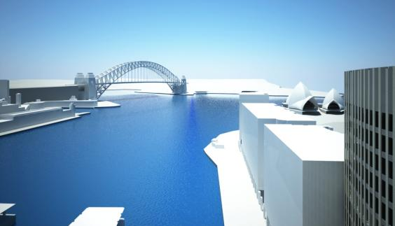
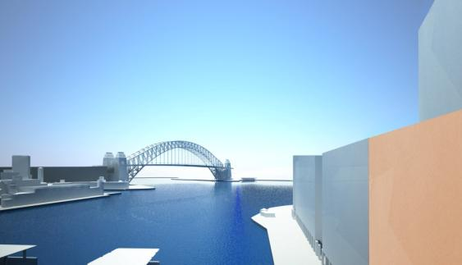
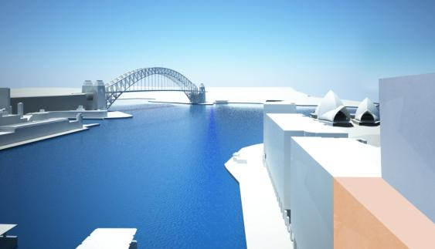
71 MACQUARIE STREET
Proposed View Impact Analysis
_Negligible impact to views from neighbouring residential properties
Existing_
View 2 - Quay Apartments RL 67 (approx)
View 1 - Quay Apartments RL 45 (approx)
Existing Building – max RL 67.23
Quay Grand – max RL 46.7
Circular Quay – RL 2.8
Proposed_
Integrated Development
View 1 - Quay Apartments RL 45 (approx)
View 2 - Quay Apartments RL 67 (approx)

Slide 11
71 MACQUARIE STREET
Proposed Building Height and Use
_No additional overshadowing to adjacent parkland
Quay Grand Height
Residential
Top Of Existing Parapet
Top Of Existing
Service Shed
Potential Lift / Service Zone
Residential –
Serviced Apartments
Top Of Proposed Parapet
Lobby / Retail
Colonnade
Basement
  Proposed roof section
  Proposed cross section

Slide 12
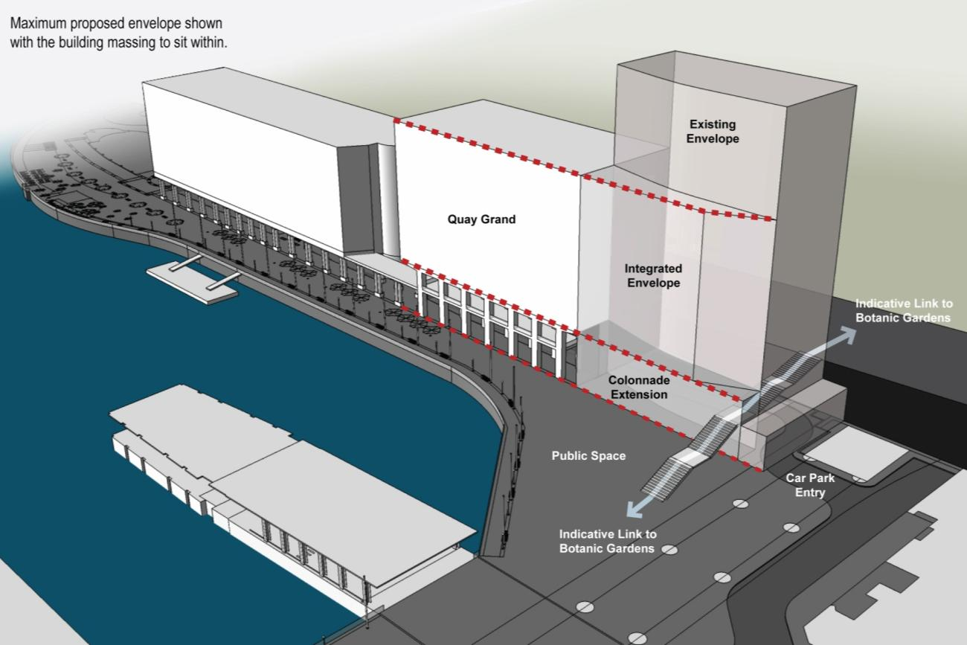
71 MACQUARIE STREET
Massing Studies

Slide 13
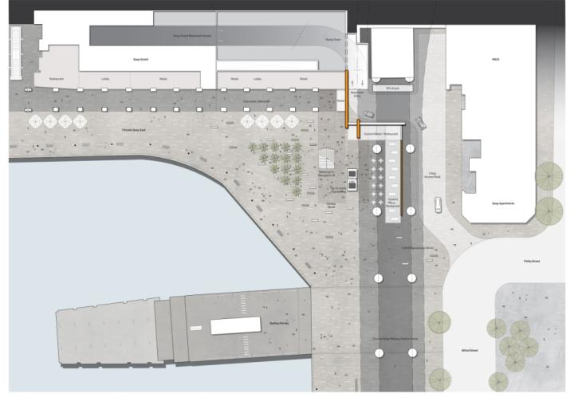
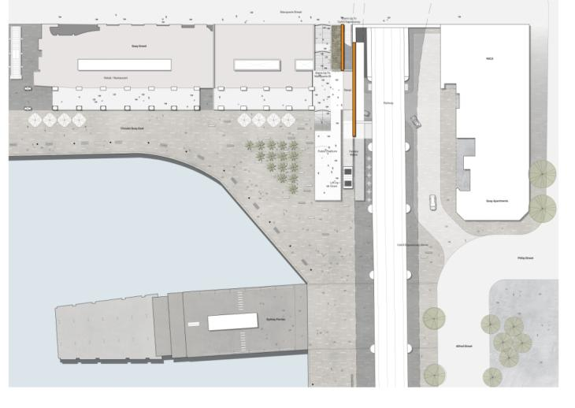
PUBLIC DOMAIN & THROUGH SITE LINK
  DESIGN STUDY – OPTION 1
  Direct link to Macquarie St and Botanic Gardens
  Termination of colonnade
  New public space
  Stair with link to upper colonnade
  Public Realm Plan - Lower Level
  Public Realm Plan – Upper Level

Slide 14
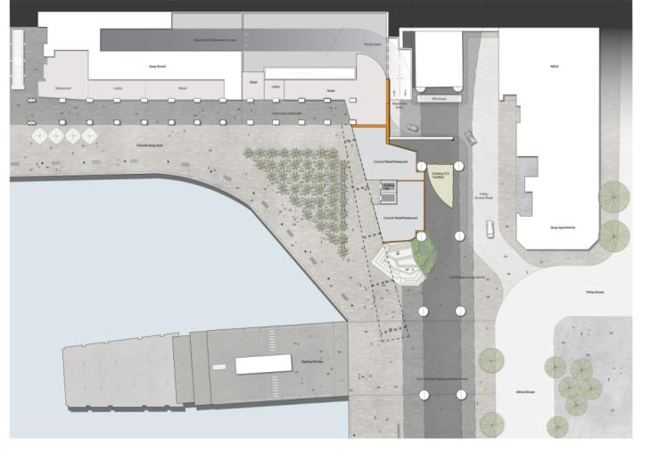
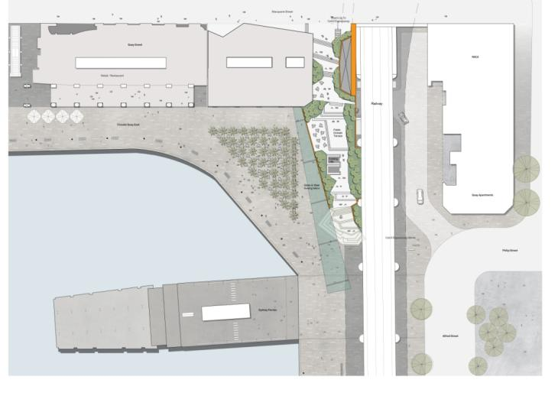
PUBLIC DOMAIN & THROUGH SITE LINK
  DESIGN STUDY – OPTION 2
  Direct link to Macquarie St and Botanic Gardens
  Termination of colonnade
  New public space
  Stair with informal platform
  Public Realm Plan - Lower Level
  Public Realm Plan – Upper Level

Slide 15
71 MACQUARIE STREET
Project Summary
  Opportunity for an integrated development to complete East Circular Quay
  Potential for improved linkages to the east
  and related public domain benefits
  _Co-operative approach with Council as landowner will be required to achieve an integrated development with public domain improvements
  _ An integrated development will not be possible without Council’s consent as landowner

